Slide 1
Airline Reservation System
using Graph Database
Department : Information Technology
Guide : Prof. Aparna Kamble
Ajinkya Ramesh Algonda B120388508
Supriya Prasanna Bagade B120388528
Shital Parashram Jadhav B120388595
Rewati Rajesh Sonar B120388692

Slide 2
Objectives
Study graph database
Design airline reservation system
Tasks :
Learn Graph database architecture
Study and use Titan, Cassandra, Elasticsearch, Git
Implementation of airline reservation system
Analyze query time of the system

Slide 3
What is Graph Database?
NOSQL database
Uses graph theory
Use graph traversal language
Examples:
Titan
Neo4j

Slide 4



Literature Survey
Paper 1: Graph Database : An Overview
Authors : Shefali Patil, Gaurav Vaswani, Anuradha Bhatia
Publication year : 2016
Used by large organizations
Widely used and well established technology

Slide 5
Literature Survey (Continued…)
Paper 2: Relational Database and Graph Database : A Comparative Analysis
Authors : Surajit Medhi, Hemanta K. Baruah
Publication year : 2017
Exponential growth of data
Better results by Graph database
Suitable for commercial development

Slide 6
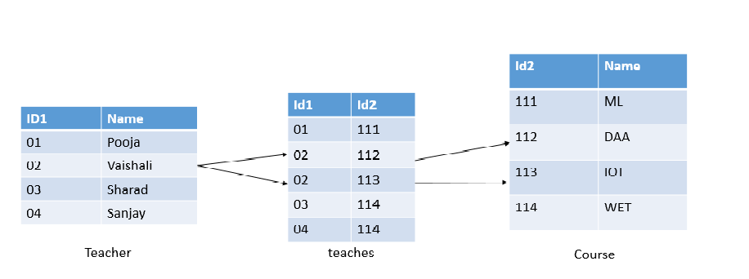
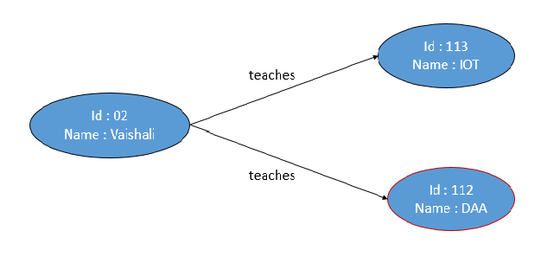
RDBMS vs Graph Database
Searching:
Query: List courses taught by teacher Vaishali

Slide 7
RDBMS vs Graph Database (Continued…)
Parameter | Relational Database | Graph Database
Suitable for | Highly structured data | Highly related data
Stores data in the form of | Tables | Graphs
For each query | Traverse whole table | Traverse only related nodes
Query time proportional to | Size of the whole table | Size of the graph traversed
Query length for complex traversal | Very long | short

Slide 8
Technologies Used
Titan Graph Database Engine
Java
Cassandra
HTML and CSS
JavaScript
Elasticsearch
Git
Maven
Rest API

Slide 9
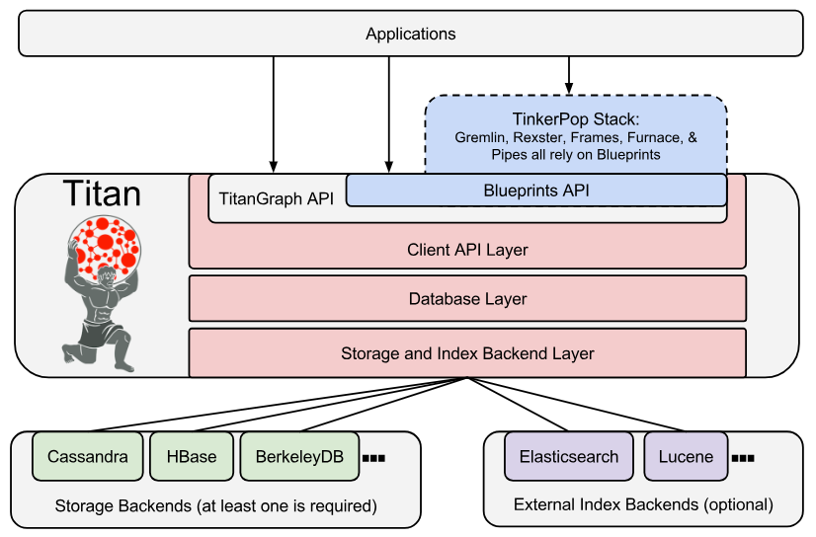
Architecture of Titan

Slide 10
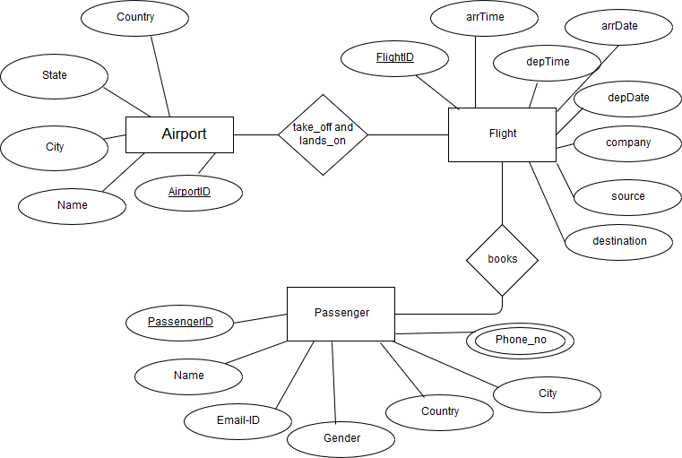
E-R Diagram

Slide 11
Demo Database
airport
flight_id: 103
Dep_time: 7:30
Arr_time: 10:00
a_id: 1
city: Pune
a_id: 3
city: Delhi
airport
flight
flight_id: 201
Dep_time: 15:30
Arr_time: 16:30
flight
flight
flight_id: 203
Dep_time: 12:00
Arr_time: 14:00
a_id: 2
city: Mumbai
airport

Slide 12
Gremlin
Traversal language used by Titan
Path-oriented
Examples:
1. List destination cities of all flights having source city Pune
gremlin> g.V.has(‘city’,’Pune’).out(‘flight’).city
=>Delhi
2. List all properties of airport in city Mumbai
gremlin> g.V.has(‘city’,’Mumbai’).map
=>a_id=2
=>city=Mumbai

Slide 13
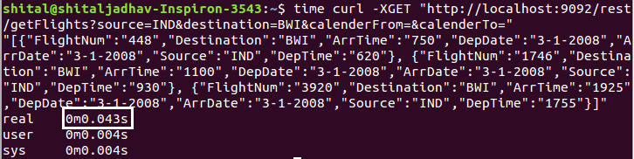
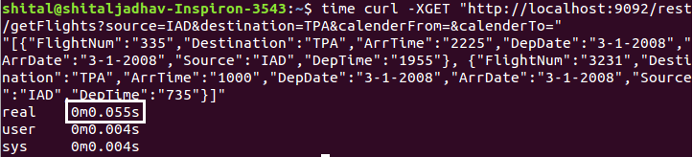
Testing
Query Time Measuring

Slide 14
Results
Sr. No. | Total no. of airports | Total no. of flights | No. of flights retrieved (avg) | Query time (sec)
1 | 15 | 100 | 6 | 0.0497
2 | 40 | 1000 | 154 | 0.0662
3 | 250 | 10000 | 363 | 0.3374
4 | 500 | 20000 | 563 | 0.9773

Slide 15
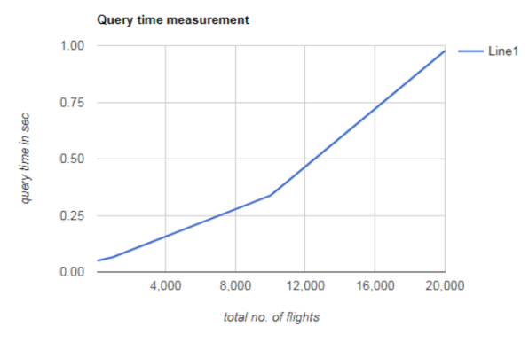
Results (Continued…)

Slide 16
Conclusion
Studied Titan Graph Database Engine
Implemented airline reservation system
Analysed query execution time for varying size of data
Query time increases linearly with increasing size of data

Slide 17
References
1. Surajit Medhi, Hemanta K. Baruah “Relational database and graph database: a comparative analysis”
2. Chad Vicknair, Michael Macias, Zhendong Zhao, Xiaofei Nan, Yixin Chen, Dawn Wilkins “A Comparison of a Graph Database and a Relational Database”, ACM Southeast Regional Conference, 2010.
3. S. Batra and C. Tyagi. Comparative analysis of relational and graph databases. International Journal of Soft Computing
4. B. Iordanov. Hypergraphdb: a generalized graph database. Web-Age Information Management, pages 25–36, 2010.
5. http://s3.thinkaurelius.com/docs/titan/1.0.0/benefits.html

Slide 18
Thank You!

